Slide 1

Steward
Transition hackathon pitch
The AI office manager that sees, fixes and escalates.
Notes:
Steward is an AI office manager. Someone snaps a photo of what’s broken, Steward works out what it is and how to fix it, and if it can’t be fixed on the spot it calls the right person with the full brief. Five slides: the problem, how it works, why it wins, and the wand.

Slide 2
Small problems eat the office manager’s day
The problem
Coffee machine is broken
The Wi-Fi is down
Each one is low value. Each one is urgent to someone.
A fuse has gone
Printer is not working
Staff interrupt the office manager, who becomes the human router for every fault, order and supplier call.
Screens need installing
Lunch needs to go out
Plants are dying
Dishwasher stopped
Notes:
Open with the list. None of these is hard, but every one lands on the office manager, and nothing is built for their job. They spend the day routing: who is it, who fixes it, who do I call. That time is the cost.

Slide 3
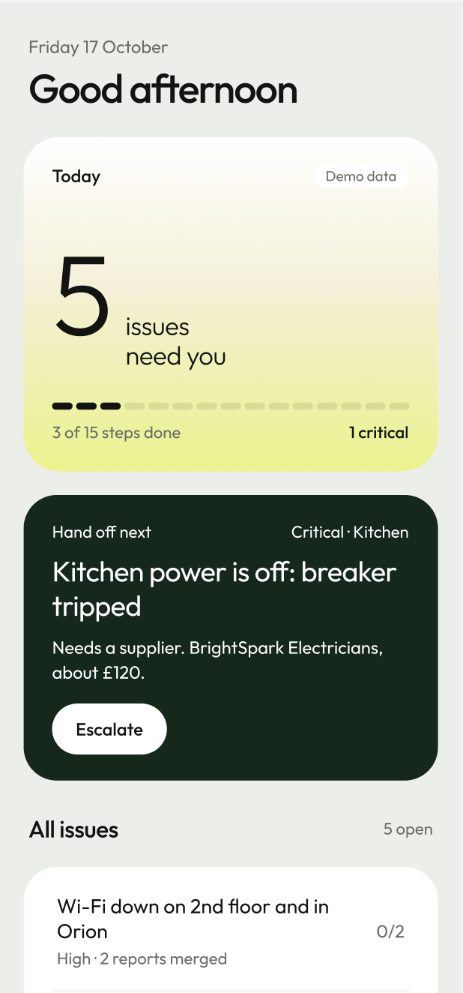
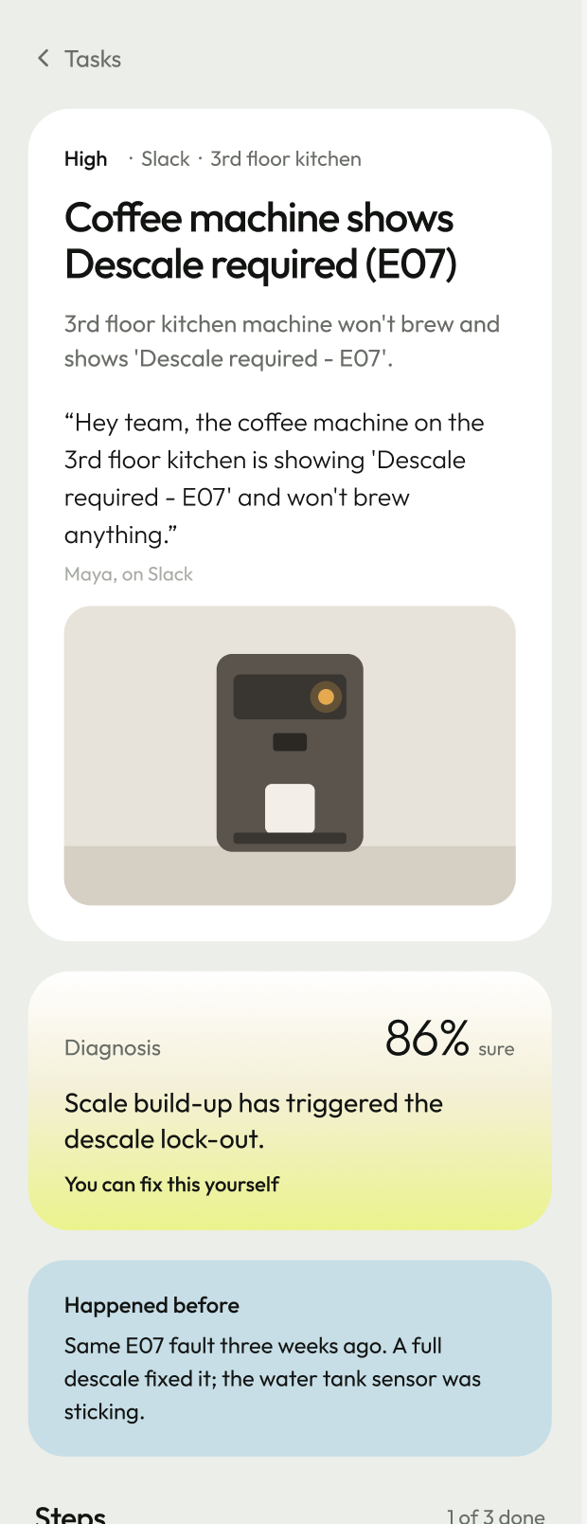
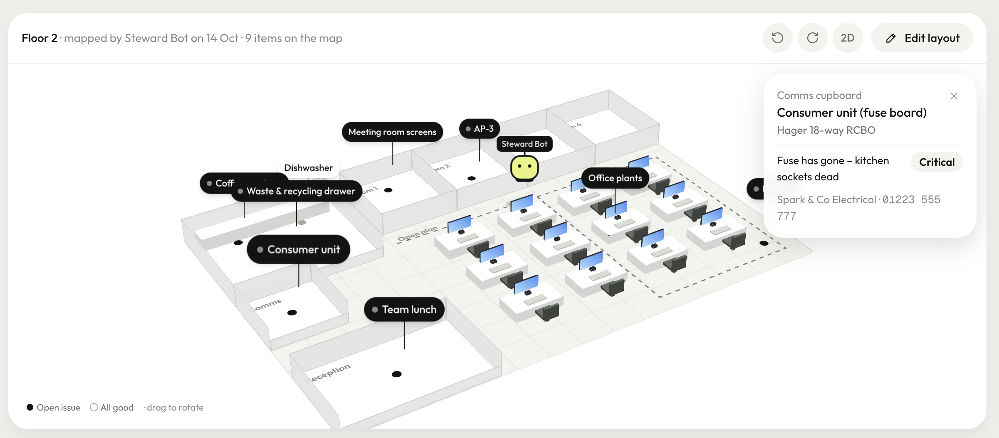
Steward the Office Manager
The Solution
Notes:
Open with the list. None of these is hard, but every one lands on the office manager, and nothing is built for their job. They spend the day routing: who is it, who fixes it, who do I call. That time is the cost.

Slide 4
Snap it. Steward does the rest.
1
2
3
4
Snap it
Read it
Remember it
Hand it off
A photo in Slack, an upload in the app, or just say what’s wrong.
Vision checks the photo against your inventory, so it knows the exact machine.
Spots duplicates and recalls what went wrong last time, and what fixed it.
Talks you through the fix, or escalates to the right supplier with the full brief.
Built on OpenAI vision, ElevenLabs voice and Slack
Notes:
Walk the four steps left to right. The colours mean something: white is the report, lime is Steward talking, blue is memory, green is handing it off. In the prototype today the vision, voice and Slack steps are simulated; the next step is wiring in OpenAI vision, ElevenLabs and Slack for real.

Slide 5
Not a general assistant
Why Steward
Memory
A data moat
Private
Every photo, fix and supplier call becomes your office’s history. General assistants start from scratch each time.
Your inventory, fault history and who fixed what grow with every issue. That is hard to copy.
Personalised to your office and your device. Your data stays yours.
Who it serves
Office managers
COO and budget holders
Suppliers
Staff
Notes:
This is the answer to “why not Meta or a general assistant”. They start from nothing every time. Steward builds a memory of your office, which is the moat, and it stays private to your office and device. The payoff: less time on small problems, fewer interruptions, and call-out spend the COO can see.

Slide 6
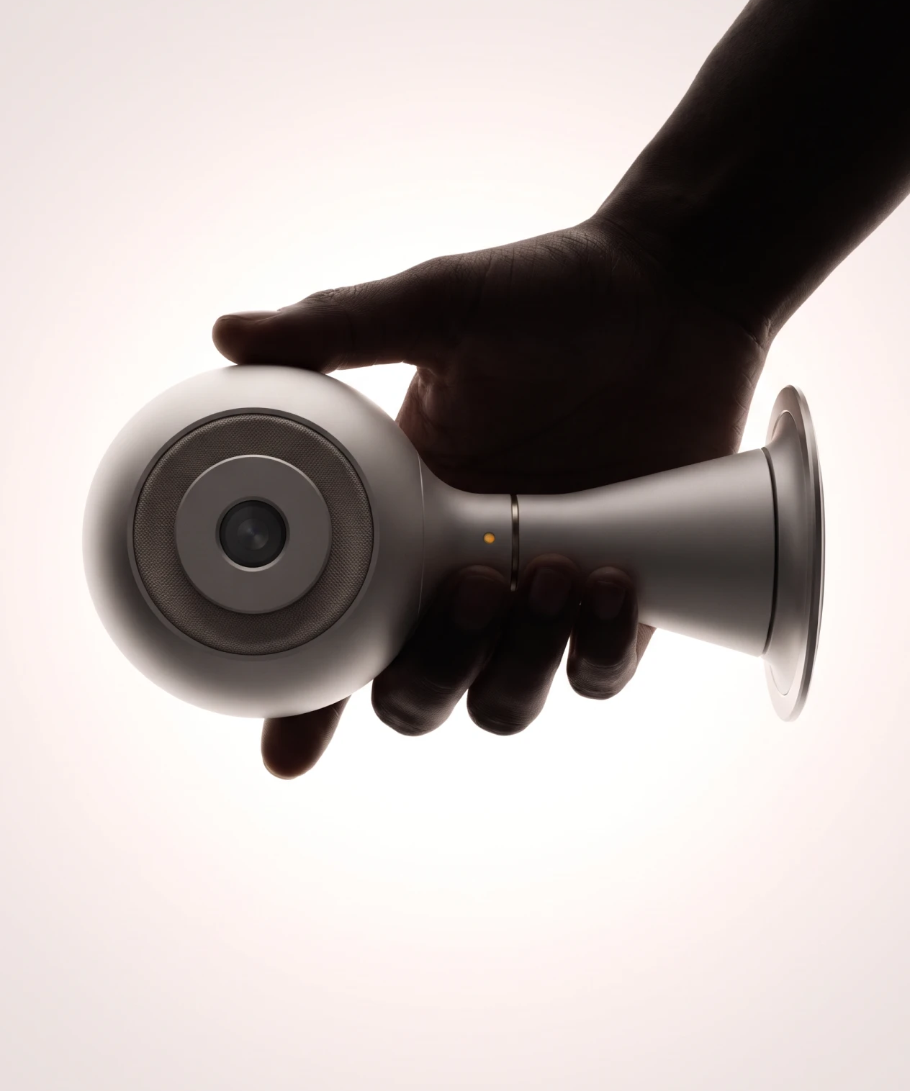
Steward wand
Meet the
Point it at the problem. Steward sees it, and tells you the fix out loud.
A camera and a speaker in one hand. Concept.
Notes:
End on the picture. The wand is how Steward leaves the screen: a camera to see the fault and a speaker to talk you through the fix, in the office manager’s hand. This is a concept visual, not a working device.

